Slide 1
Lesson 12
Debugging Subprograms

Slide 2
Objectives
After completing this lesson, you should be able to:
  Describe the functionality of the SQL Developer debugger
  Debug Subprograms
  Use various features of SQL Developer debugger for debugging

Slide 3

Lesson Agenda
  Before debugging PL/SQL subprograms
  Debugging a subprogram
  Using the debugging Log Tab toolbar
  Debugging a procedure

Slide 4


Before Debugging PL/SQL Subprograms
Before you start debugging PL/SQL Subprograms, you should have the following privileges:
  DEBUG CONNECT SESSION privilege
  DEBUG ANY PROCEDURE privilege
  EXECUTE privilege on DBMS_DEBUG_JDWP
  EXECUTE privilege on the object you want to debug

Slide 5
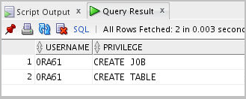

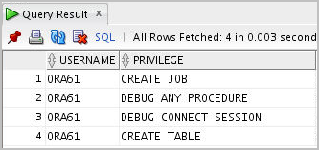
Before Debugging PL/SQL Subprograms
You can look at the privileges of the current user by executing the following statement:
SELECT * from user_sys_privs;
ORA61 does not have DEBUG CONNECT SESSION and DEBUG ANY PROCEDURE privileges. You can grant them by executing the following statements as a SYSDBA role user.
GRANT DEBUG ANY PROCEDURE TO ora61;
GRANT DEBUG CONNECT SESSION TO ora61;
-- Login as ora61
select * from user_sys_privs;

Slide 6
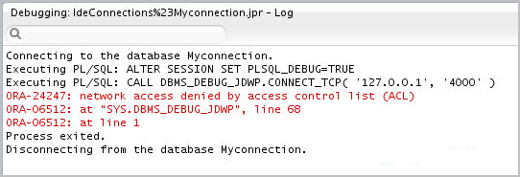


Before Debugging PL/SQL Subprograms
You might encounter the following error while running the SQL debugger in Oracle 12c
The error implies that the current database session is trying to establish a connection with the debugger on the local host, but not able to do so.

Slide 7

Before Debugging PL/SQL Subprograms
You have to execute the following PL/SQL block to grant the jdwp ACL privilege as a SYSDBA role user.
BEGIN
DBMS_NETWORK_ACL_ADMIN.APPEND_HOST_ACE
(
host => '127.0.0.1',
lower_port => null,
upper_port => null,
ace => xs$ace_type(privilege_list => xs$name_list('jdwp'),
principal_name => 'ora61',
principal_type => xs_acl.ptype_db)
);
END;

Slide 8
Lesson Agenda
  Before debugging PL/SQL subprograms
  Debugging a subprogram
  Using the debugging Log Tab toolbar
  Debugging a procedure

Slide 9
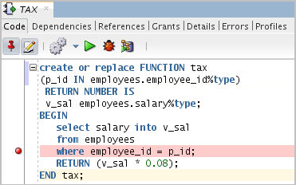
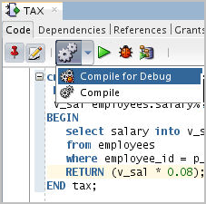
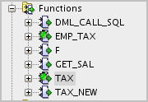

Debugging a Subprogram: Overview
Subprogram Compiled for Debug
1. Add Breakpoints
2. Compile for Debug
3. Debug

Slide 10
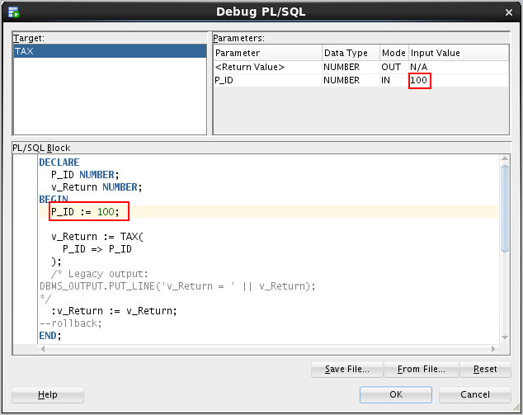
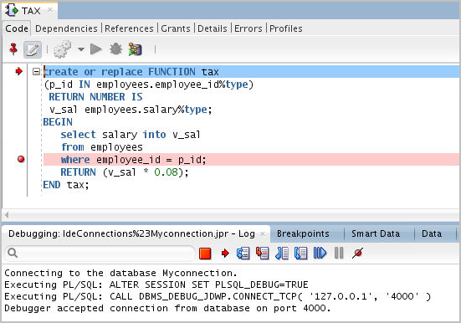
Debugging a Subprogram: Overview

Slide 11
Lesson Agenda
  Before debugging PL/SQL subprograms
  Debugging a subprogram
  Using the debugging Log Tab toolbar
  Debugging a procedure

Slide 12




The Debugging – Log Tab Toolbar
3
1
2
4
Icon | Description
1. Terminate | Halts and exits the execution
2. Find Execution Point | Goes to the next execution point
3. Step Over | Bypasses the execution of statements of a subprogram invoked from the current subprogram and executes the statement after the subprogram call
4. Step Into | Executes a single program statement at a time. If the execution point is located on a call to a subprogram, it steps into the first statement in that subprogram.

Slide 13




The Debugging – Log Tab Toolbar
5
7
9
6
8
Icon | Description
5. Step Out | Leaves the current subprogram and goes to the next statement with a breakpoint
6. Step to End of Method | Goes to the last statement of the current subprogram
7. Resume | Continues execution
8. Pause | Halts execution but does not exit
9. Suspend all breakpoints | Turns off all the breakpoints in the current PL/SQL block

Slide 14



Tracking Data and Execution
1
2
3
4
Tab | Description
1. Breakpoints | It displays breakpoints, both system defined and user defined.
2. Smart Data | Displays information about variables. You can specify these preferences by right-clicking in the Smart Data window and selecting Preferences.
3. Data | You can see the data in all the variables.
4. Watches | You can monitor all the watches set while debugging.

Slide 15
Lesson Agenda
  Before debugging PL/SQL subprograms
  Debugging a subprogram
  Using the debugging Log Tab toolbar
  Debugging a procedure

Slide 16
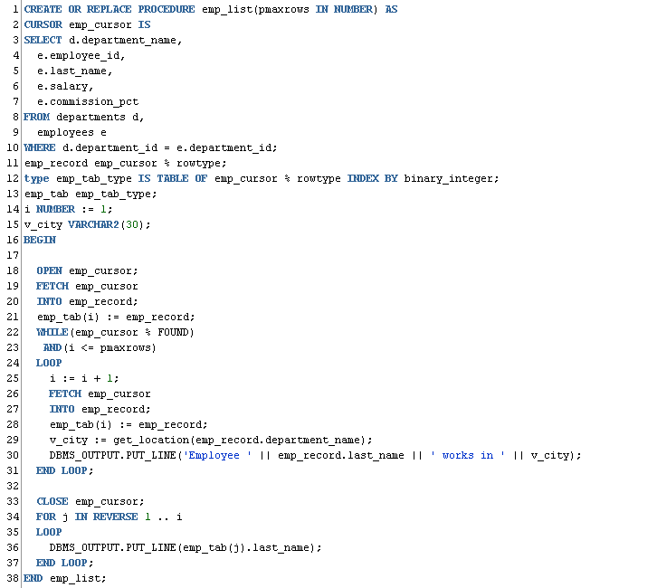
Debugging a Procedure Example:
Creating a New emp_list Procedure

Slide 17
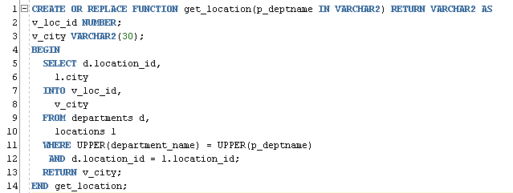
Debugging a Procedure Example:
Creating a New get_location Function

Slide 18
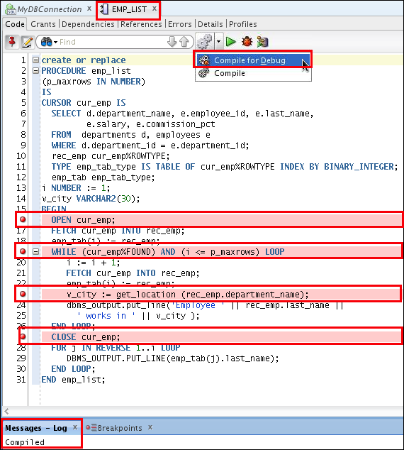
Setting Breakpoints and Compiling emp_list for Debug Mode

Slide 19
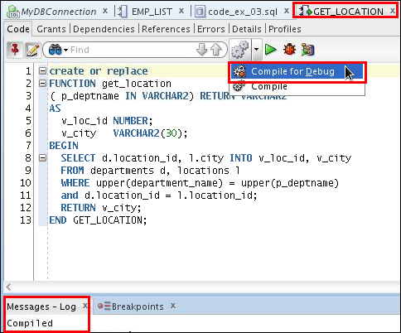
Compiling the get_location
Function for Debug Mode

Slide 20
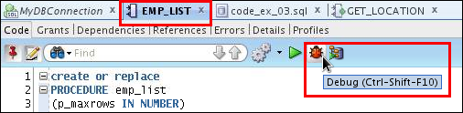
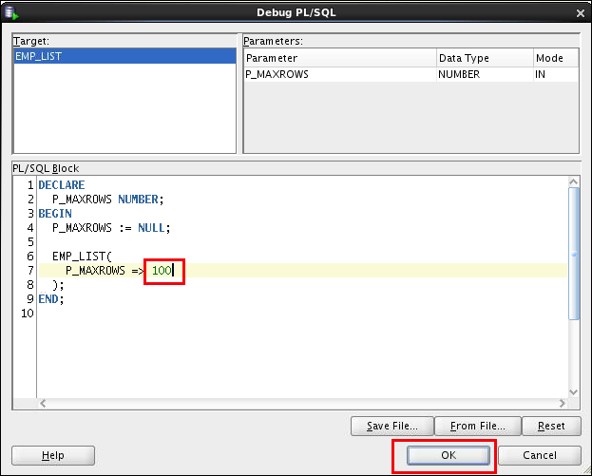
Debugging emp_list and Entering
Values for the PMAXROWS Parameter
Enter the procedure’s
parameter value using the
anonymous block.

Slide 21
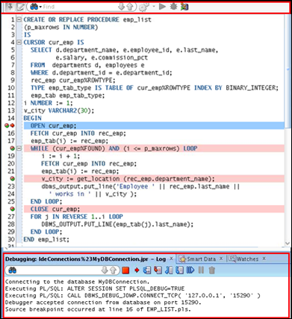

Debugging emp_list: Step Into (F7) the Code
2
Value
Program
control stops at
first breakpoint.
Unique key column
Unique key column
Unique key column
Unique key column
1

Slide 22

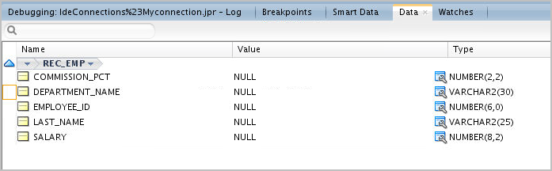

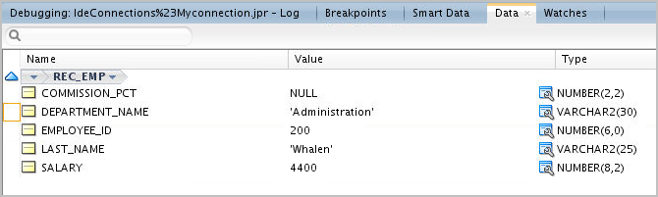
Viewing the Data

Slide 23

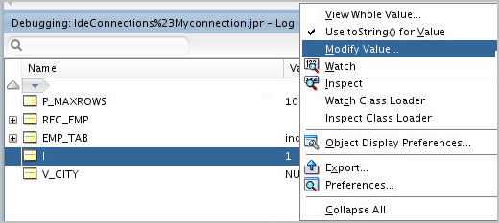

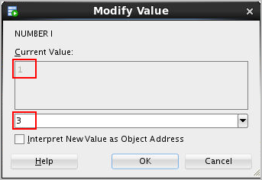

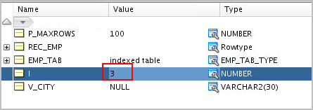
Modifying the Variables While Debugging the Code
1
2
3

Slide 24
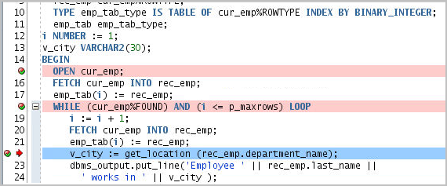
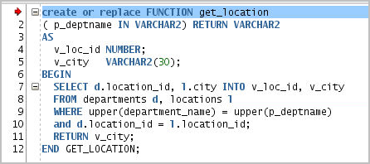
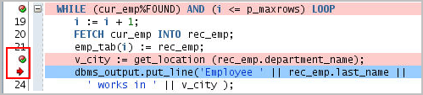
Debugging emp_list: Step Over Versus Step Into
Step Into
Step Over

Slide 25
Debugging emp_list:
Step Out of the Code (Shift + F7)
Step Out

Slide 26
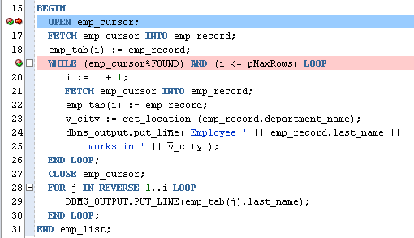
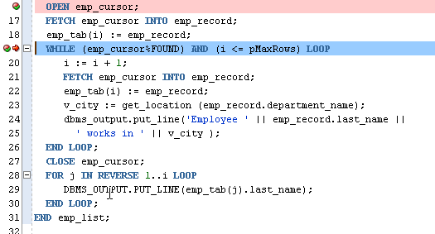
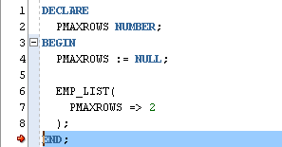
Debugging emp_list: Step to End of Method
Loops until i <> PMAXROWS

Slide 27
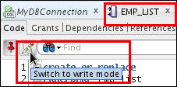
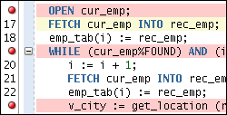
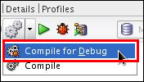
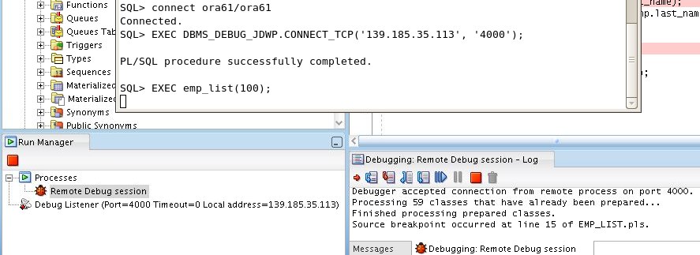
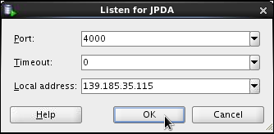
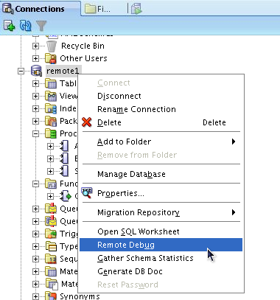
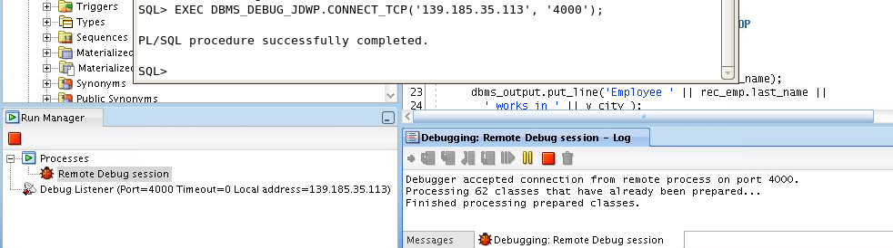
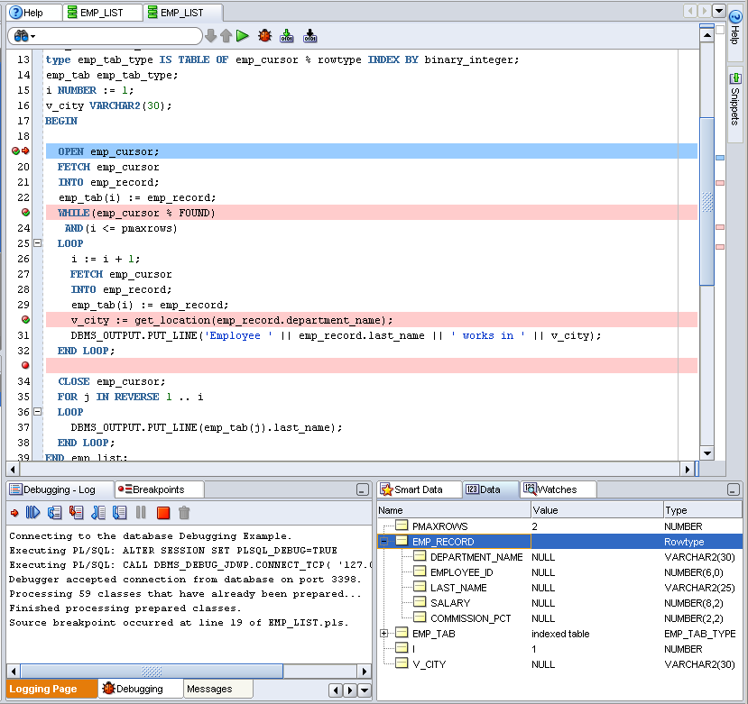
Debugging a Subprogram Remotely: Overview
1. Edit procedure.
2. Add breakpoints.
3. Compile for Debug.
6. Issue the debugger
connection command and call
procedure in another
session such as SQL*Plus.
5. Enter local machine IP
address and debugging port.
4. Select Remote Debug.
7. When the breakpoint is reached,
control passes to SQL Developer.
8. Debug and monitor data
using debugging tools.

Slide 28
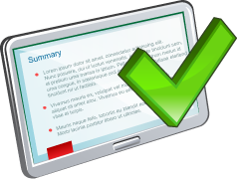
Summary
In this lesson, you should have learned how to:
  Describe the basic functionality of the SQL Developer debugger
  Run the debugging process
  Use various features that can be used while debugging

